Slide 1
University ChatBot
Jingze LIU
Yuyan ZHAO
Ruxin ZHENG
Kehan LIU
Menglin XIONG

Slide 2
Content
Introduction
Training Data
Pipeline
Run Example
Conclution

Slide 3
CHAPITRE 1
Introduction

Slide 4
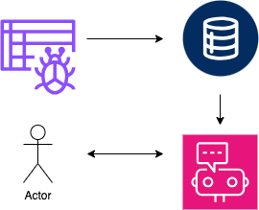
Introduction
Main objective: We have developed a chatbot which can be used in the university official website. This bot is capable of answering questions about basic university information, querying teacher public informations, and recommending suitable majors based on personal preferences.
Data source : web crawler
Language framework: Rasa

Slide 5
CHAPITRE 2
Training Data

Slide 6
Intents
1. Basic Interactions:
- greet, goodbye, bot_challenge, stop
2. General Information About the University:
- university_info, university_size, university_history, university_location, campus_info
3. Teacher Information:
- teacher_info: Retrieve public information about a specific teacher, including his/her personal profile and contact detail
4. Major Recommendations
- recommend_major: Recommend majors based on the user's interested domain and preferred campus.
5. Contact User
- contact_me: The user requests contact and leaves contact information

Slide 7
Entities, Forms
- university: The name of a university or terms referring to a university.
- teacher_title: The title of a teacher, such as professor, lecturer, etc.
- PERSON: A person's name. It’s an entity type already defined in SpacyEntityExtractor
- domain: The field of study or research, such as computer science, health studies, etc.
- campus: The campus of the university.
- phone: phone number
- email: email address
- major_form: The form used to recommend a major based on domain and campus

Slide 8
Rules
Rules describe short conversations that should always follow the same path.
- Say goodbye anytime the user says goodbye
- Say 'I am a bot' anytime the user challenges
- Say 'I can't understand' when unable to predict an action (FallbackClassifier)
- Activate major_form when the intent recommend_major is detected
- Submit major_form after filling the required slots

Slide 9
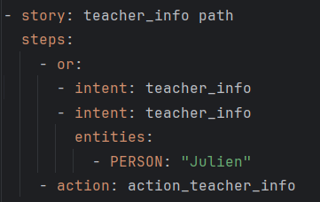
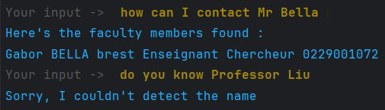
Stories
Stories are training data that can help to generalize to unseen conversation paths.
Simple stories: intent - action
greet path, about_university path, university_size path, university_history path, university_location path
teacher_info path
User expresses the intent to inquire about teacher information, with or without a specific teacher name. (in case the teacher name was not recognized as a PERSON entity)

Slide 10
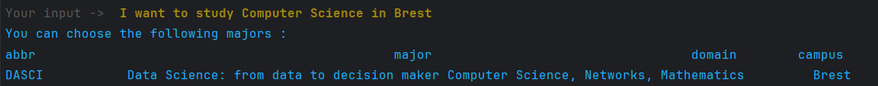
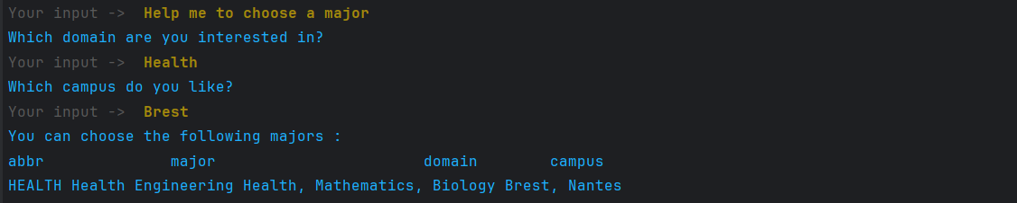
Stories
major_form with stop
The user expresses the intent to request recommendations for majors, with or without his/her interested domain or prefered campus.
If the bot hasn't collected complete information for the domain or campus fields, it should prompt the user to provide the missing information until the form is completed. User can use “stop” to quit the loop

Slide 11
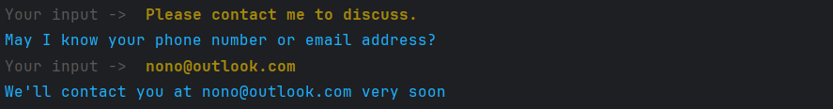
Stories
contact_me with contact info path, contact_me without contact info path
The user requests contact and leaves phone number or email
If the bot hasn't collected at least one of these information, it prompts the user to provide either a phone number or an email address.

Slide 12
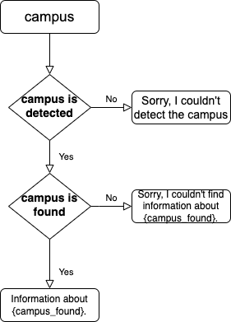
Actions
1. GetCampusInfo
Used to get information about a campus. It extracts the campus name from the user’s message and then looks up the corresponding information.
Input : Campus name
Output :
If teacher information is found, a message in text form is returned containing the campus name and the introduction of this campus;
if no name is found,“Sorry, I couldn't detect the name” will be sent;
if no campus information is found, “Sorry, I couldn't detect the name” will be sent.
Notes:
action_recommend_major
- action_major_form_submit

Slide 13
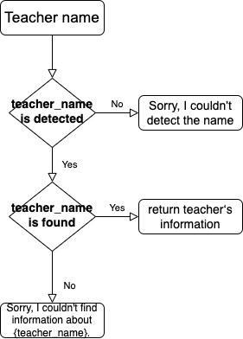
Actions
2. GetTeacherInfo
Used to get information about a teacher. It extracts the teacher’s name from the user’s message and then looks up the corresponding information.
Input : Teacher name
Output :
If teacher information is found, a message in text form is returned containing the teacher’s name, department, title and e-mail;
if no name is found,“Sorry, I couldn't detect the name” will be sent;
if no teacher information is found, “Sorry, I couldn't detect the name” will be sent.
Notes:
action_recommend_major
- action_major_form_submit

Slide 14
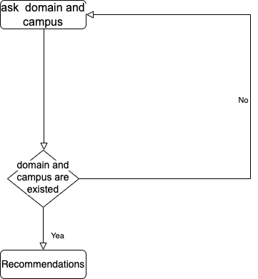
Actions
3. MajorFormAction
Used to submit the form where users can select areas of interest and school districts.
Input : User-provided field and campus information
Output :
If both are found, the corresponding recommendations of major are given;
if only field is found, “Which campus do you like?” will be sent;
if only campus is found, “Which domain are you interested in?” will be sent;
if both are not found, one of questions are sent.
Notes:
action_recommend_major
- action_major_form_submit

Slide 15
CHAPITRE 3
Pipeline

Slide 16
Components
Language Models
SpacyNLP
Tokenizers
WhitespaceTokenizer, SpacyTokenizer
Featurizers
SpacyFeaturizer, RegexFeaturizer, LexicalSyntacticFeaturizer, CountVectorsFeaturizer
Entity Extractors
DIETClassifier, RegexEntityExtractor, EntitySynonymMapper, SpacyEntityExtractor
Intent classifier
DIETClassifier, LogisticRegressionClassifier, FallbackClassifier
Selectors
ResponseSelector
Notes:
https://rasa.com/docs/rasa/components/#entitysynonymmapper

Slide 17
Pipeline
SpacyNLP : Initializing Spacy Structures :"en_core_web_md"
SpacyTokenizer : Segmentation using SpaCy to cut input text into words or phrases
SpacyFeaturizer - Grammar Driven Component
RegexFeaturizer - Grammar Driven Component
LexicalSyntacticFeaturizer - Grammar Driven Component
CountVectorsFeaturizer : The input text change to vectors representing the number
DIETClassifier - Learning Driven component
EntitySynonymMapper : Mapping of identical or similar entity values to harmonized standard values
ResponseSelector - Select specific responses or actions based on user inputs
FallbackClassifier : Avoid the system outputting meaningless responses

Slide 18
Grammar-driven component
RegexFeaturizer
object: matching text patterns
Function:
1. Specific Pattern Recognition
2.Feature Extraction
3.Input for Machine Learning Models
4.Auxiliary Information Extraction (AIE)
SpacyFeaturizer
object: Converting textual data into feature representations that can be processed by machine learning models
Function:
1.Tokenization
2.Part-of-Speech Tagging
3.Dependency Parsing
4.Named Entity Recognition (NER)
5.Word Embedding
LexicalSyntacticFeaturizer
object: Analyzing the lexical and syntactic structure of texts
Function:
1.Lexical feature extraction
2.Syntactic Feature extraction
3.Enhancement of model performance
4.Linguistic Information Capture
5.Customization

Slide 19
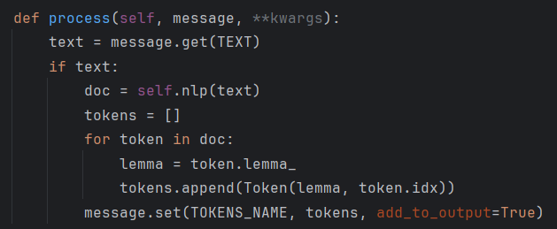
Improvements with lemmatization
Create a custom Rasa tokenizer component and use SpaCy for lemmatization
I'm really fascinated by computers, programming, and artificial intelligence.
->
I am really fascinate by computer, program, and artificial intelligence
Notes:
A critical step in this process is lemmatization, which is the transformation of words to their base or dictionary form.
firstly the input of the customer is tokenized by spacyTokenizer, Then one of the Token objects's attribute, which is .lemma_ gives you the lemma or the base form of the word.
so that the lemma of each token is extracted.

Slide 20
Learning-Driven component
LogisticRegressionClassifier
(Machine learning)
Object: Perform intent classification by scikit-learn's logistic regression implementation
Function:
In general, this classifier should train faster and may be used as a lightweight benchmark, but DIET should yield higher accuracy results.
DIETClassifier
(Deep learning)
Object: Dialog intent classification and entity extraction
Function:
Intent Classification
Entity Extraction
Contextual Understanding of Dialogue
Model Training and Fine-tuning

Slide 21

Knowledge-driven component
synonym of university
college
school
institution
academy
educational institution
higher education institution
EntitySynonymMapper
Entity : university
Notes:
as for knowledge-driven component.' here we use the EntitySynonymMapper.
its role is to map various ways a user might refer to the same concept to a single entity in our system.
here we by defining the Synonym of our entity university by college…., When a user input contains any of these terms, the EntitySynonymMapper ensures they are all understood as referring to 'university.'
This not only reducing the complexity of understanding varied inputs but also enhances the robustness of our system's entity recognition capabilities.

Slide 22
CHAPITRE 4
Chatbot Run Example
Notes:
.

Slide 23
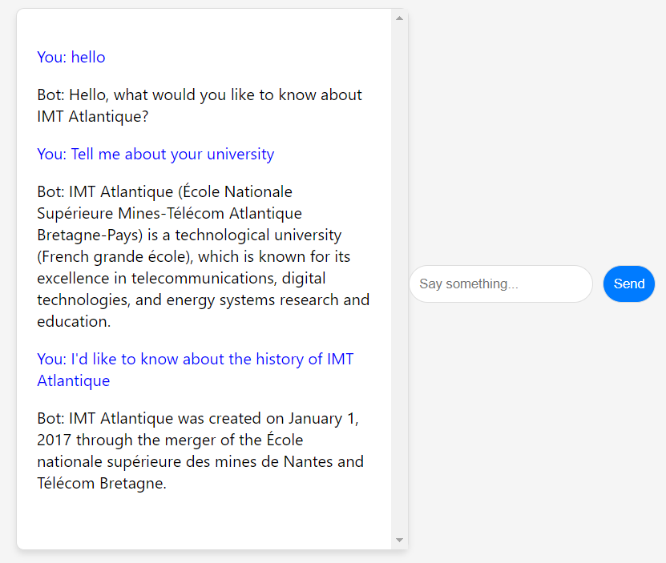
Run example

Slide 24
CHAPITRE 5
Conclution
Notes:
.

Slide 25
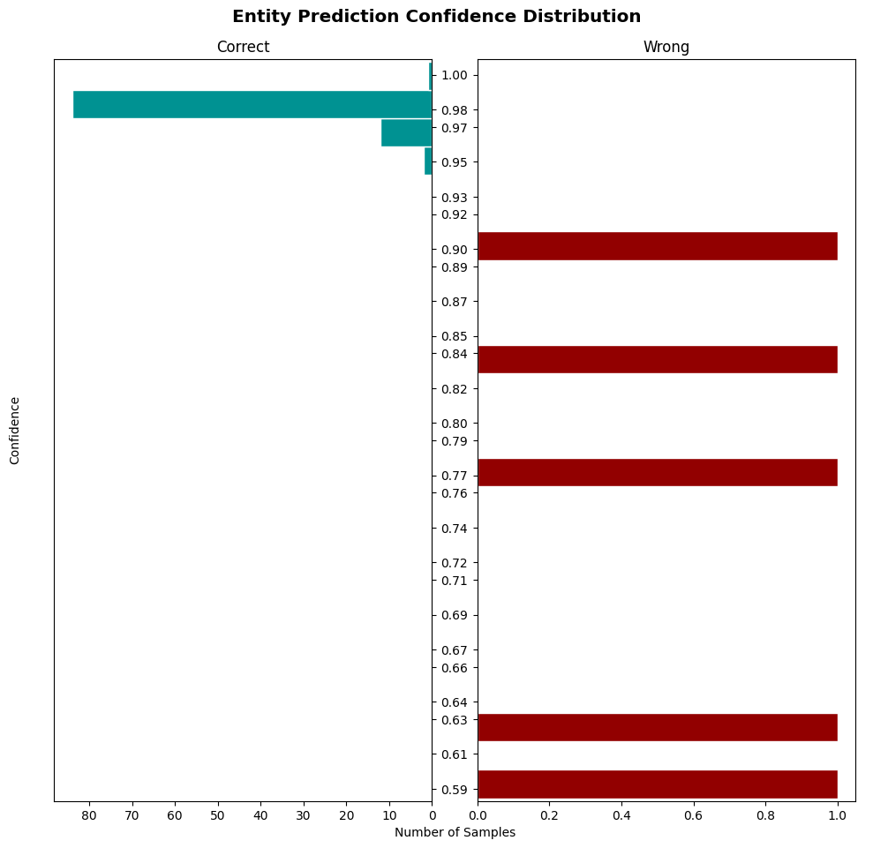
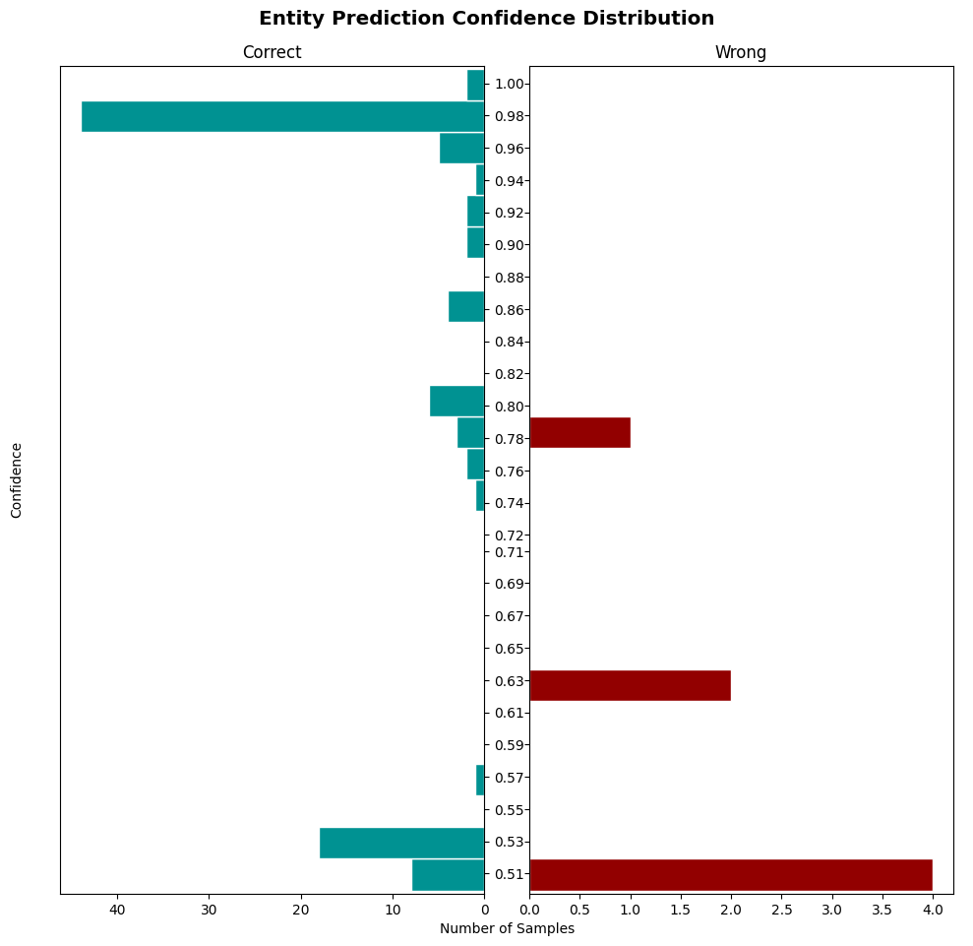
Conclusion
Entity Prediction Confidence Distribution
Default pipeline
Spacy pipeline
Notes:
To evaluate two NLU pipelines: Rasa's default and a SpaCy-enhanced version.
We focus on how confidently each pipeline predicts entities.
Here the graphs show the confidence prediction distribution; Where X is the number of samples; and y is the confidence level.
higher confidence scores, closer to 1, are preferable.
The default pipeline shows strong confidence in correct predictions but also some incorrect ones with varying certainty.
In contrast, the SpaCy pipeline displays not only high confidence in its correct predictions but also fewer errors with misplaced confidence, indicating enhanced entity recognition accuracy.
In summary, while both pipelines perform effectively, the SpaCy pipeline demonstrates a slight edge in reliability for entity prediction, with a trend towards fewer high-confidence errors.
spacyNLP
spacyentityextracter -- NER -- used for teachername recognition
The rasa test nlu command is a powerful tool provided by Rasa to evaluate our Natural Language Understanding (NLU) model."

Slide 26
Thanks !

